Slide 1


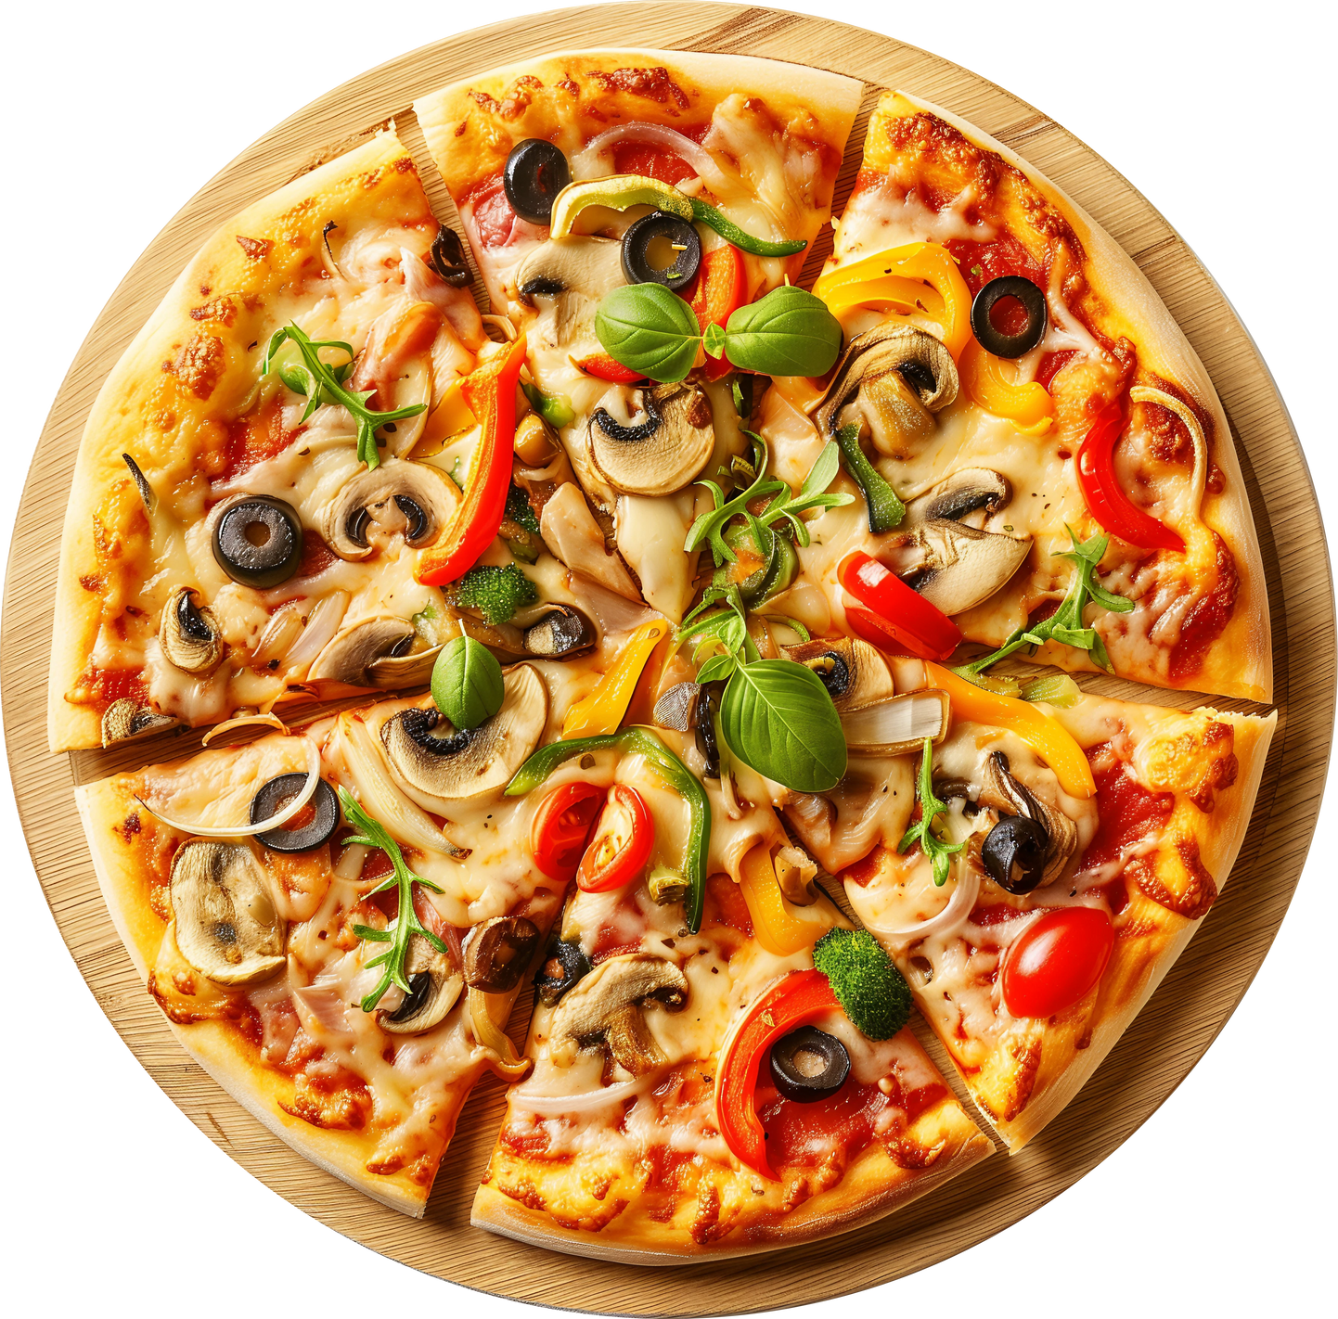

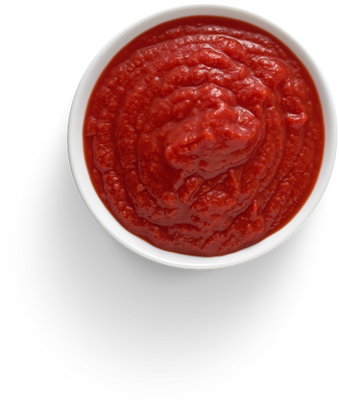

DATA SLICE & INSIGHTS:
PIZZA STORE SALES ANALYSIS USING SQL
Data Analytics Project
Analyzed a pizza store dataset using SQL to uncover sales patterns, revenue drivers, and product performance.

Slide 2



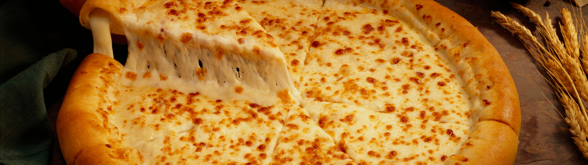

PROBLEM STATEMENT
The pizza business wants to understand:
Sales performance
Peak order times
Best-selling items
Revenue contribution by type & category
Customer order behavior
Yawar Ali
Head Chef Analytics

Slide 3
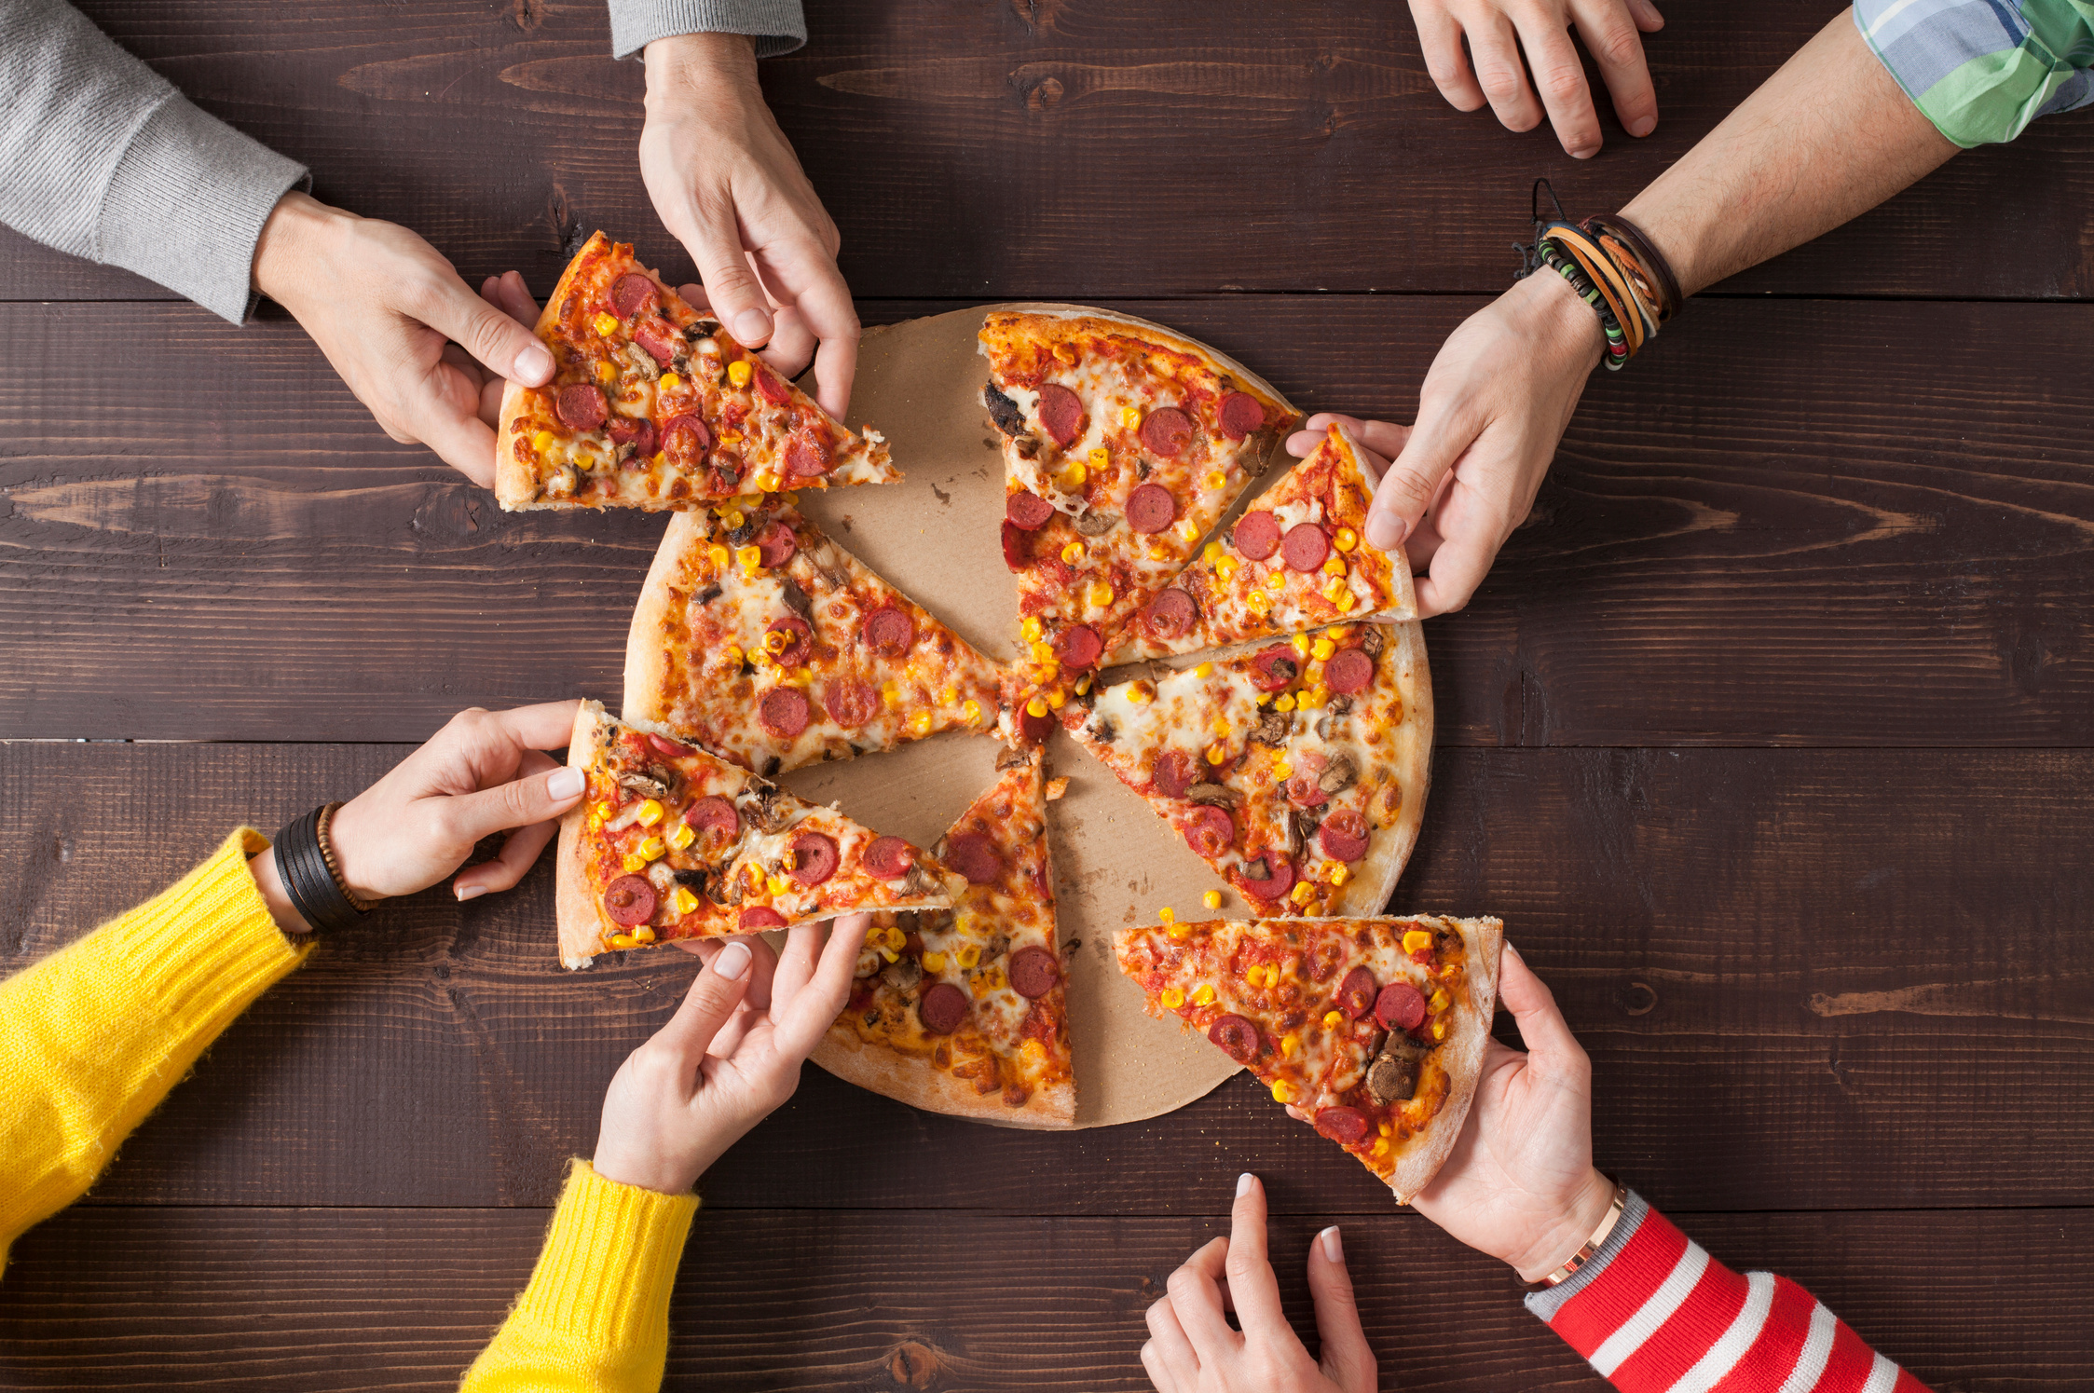
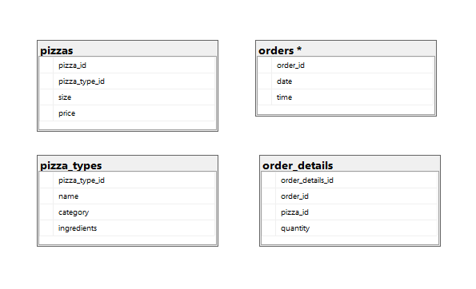


ABOUT OUR DELICIOUS PIZZA DATASET
Tables used:
order_details
orders
pizza_types
pizzas
Find dataset here.
Figure 1: This is an ERD for database.

Slide 4
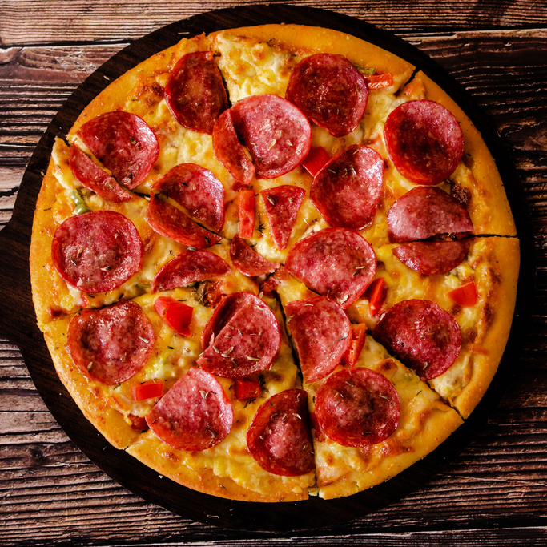
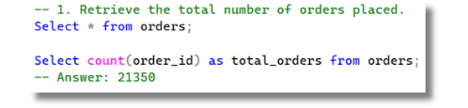
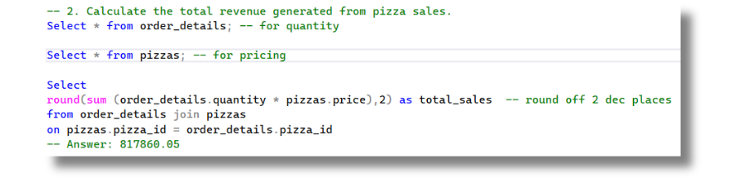
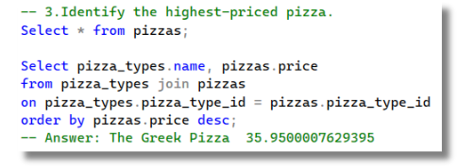
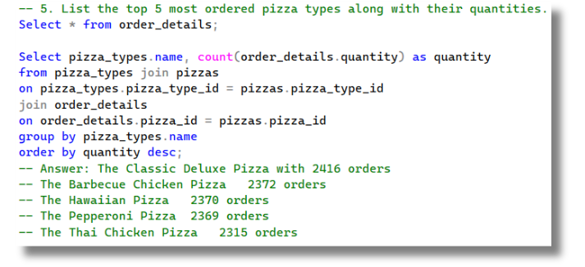

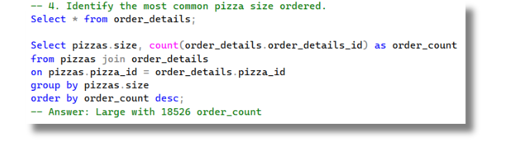
FOUNDATIONAL
METRICS
KPIs Analyzed
✔ Total Orders: 21,350
✔ Total Revenue: $817,860.05
✔ Highest-Priced Pizza: The Greek Pizza ($35.95)
✔ Most Ordered Size: Large (18,526 orders)
✔ Top 5 Pizza Types by Orders:
Classic Deluxe, BBQ Chicken, Hawaiian, Pepperoni, Thai Chicken
These results help understand overall demand and high-level sales behavior.

Slide 5

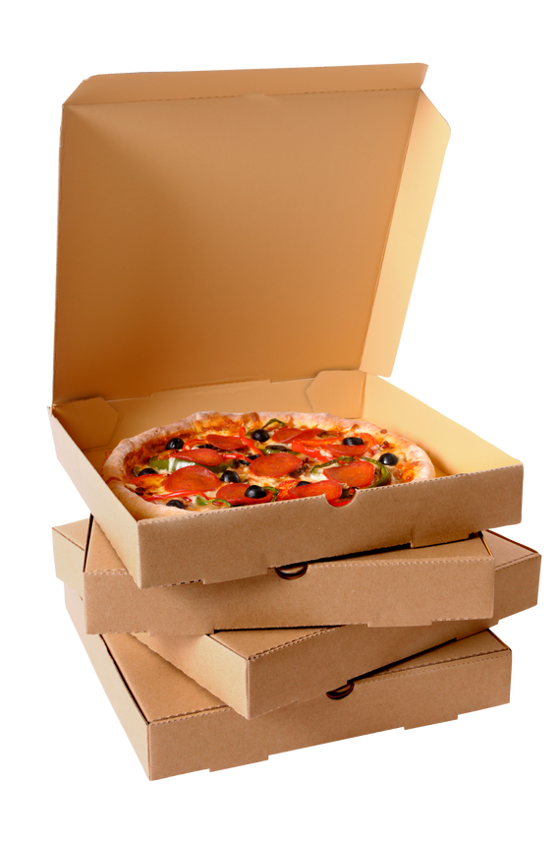
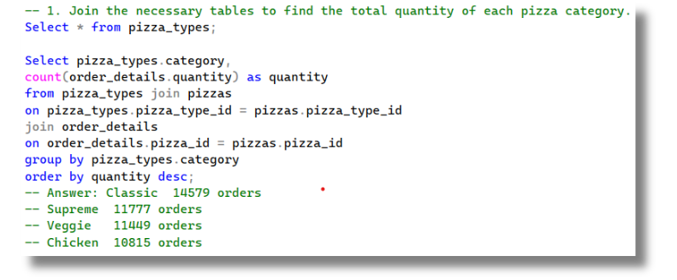
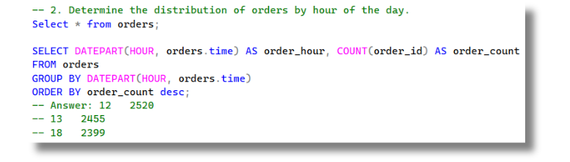

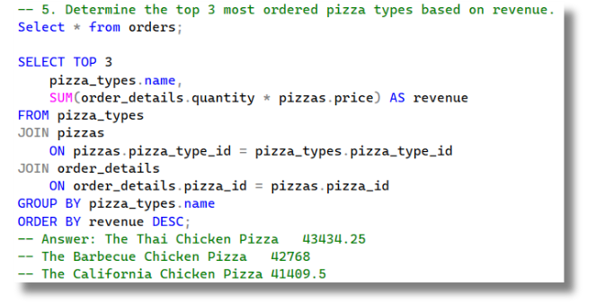
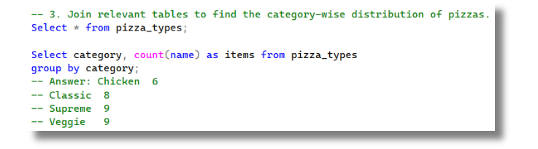
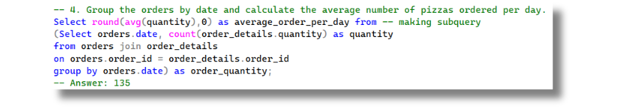
OPERATIONAL ANALYSIS
Order volume peaks between 6–8 PM. Classic and Veggie categories perform strongest.
KPIs Analyzed
✔ Total Quantity Sold by Pizza Category
✔ Peak Order Hours
✔ Category-Wise Pizza Variety
✔ Average Number of Pizzas Ordered per Day
✔ Top 3 Pizza Types by Revenue

Slide 6
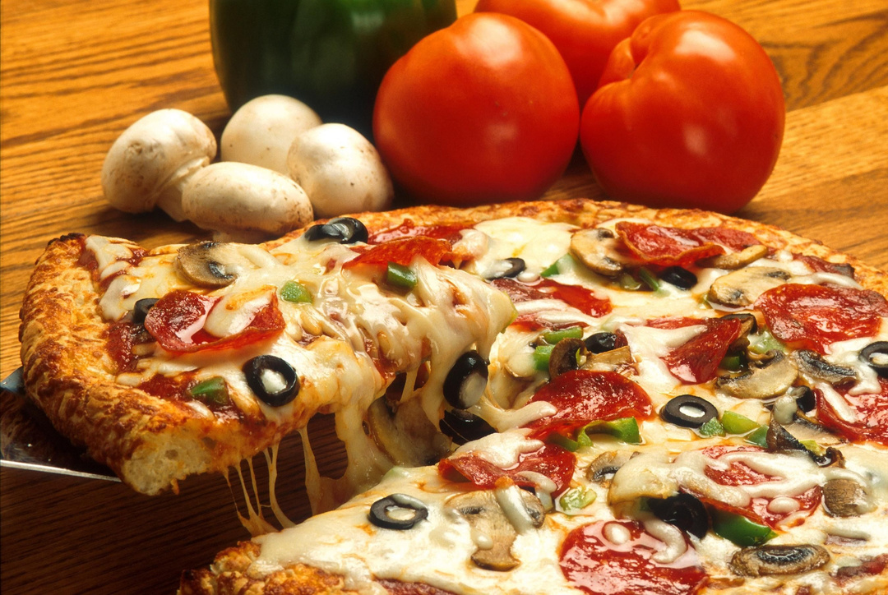
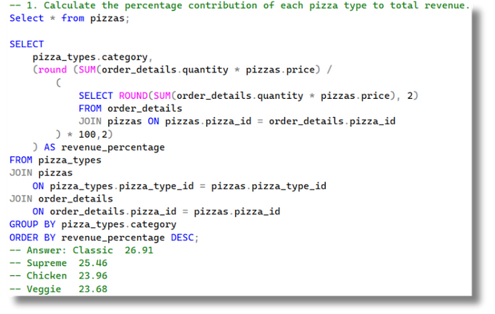
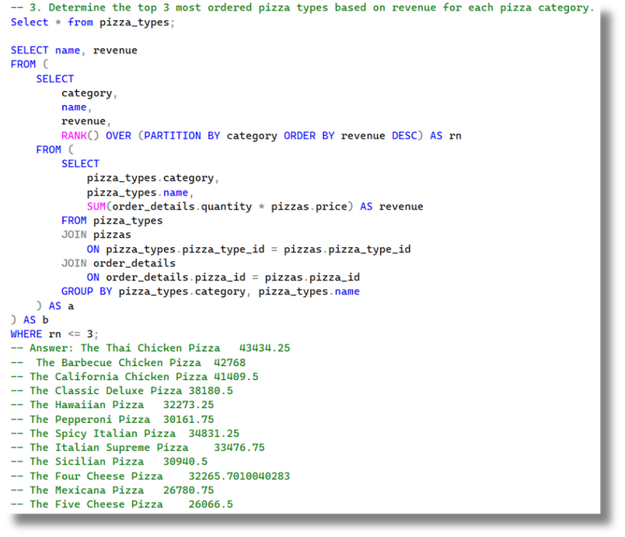
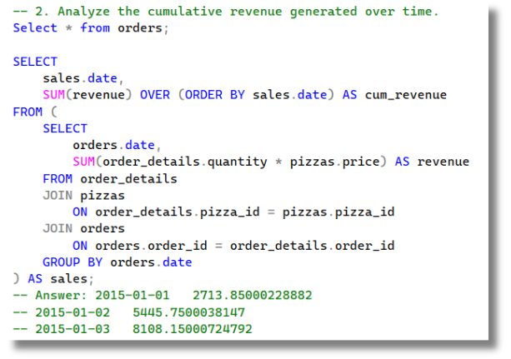
STRATEGIC FINDINGS
KPIs Analyzed
✔ Contribution % to Total Revenue by Pizza Category
✔ Cumulative Revenue Over Time
✔ Top 3 Pizza Types by Revenue for Each Category
These insights help identify high-value products that drive profitability.

Slide 7






BUSINESS IMPACT
Identified peak ordering times for staffing and inventory planning.
Highlighted high-revenue pizza types and categories for targeted promotions.
Revealed most popular pizza sizes and flavors, helping optimize menu design.
Showed daily revenue trends, supporting forecasting and sales strategy.
WHAT I LEARNED
Writing optimized SQL queries to answer real business questions.
Translating raw data into actionable business insights.
01
02
Using joins, aggregations, and window functions for advanced analysis.
Visualizing and summarizing findings for reports and presentations.
03
04
Strengthening data storytelling skills to communicate results effectively.
05
06
Helps optimize menu

Slide 8
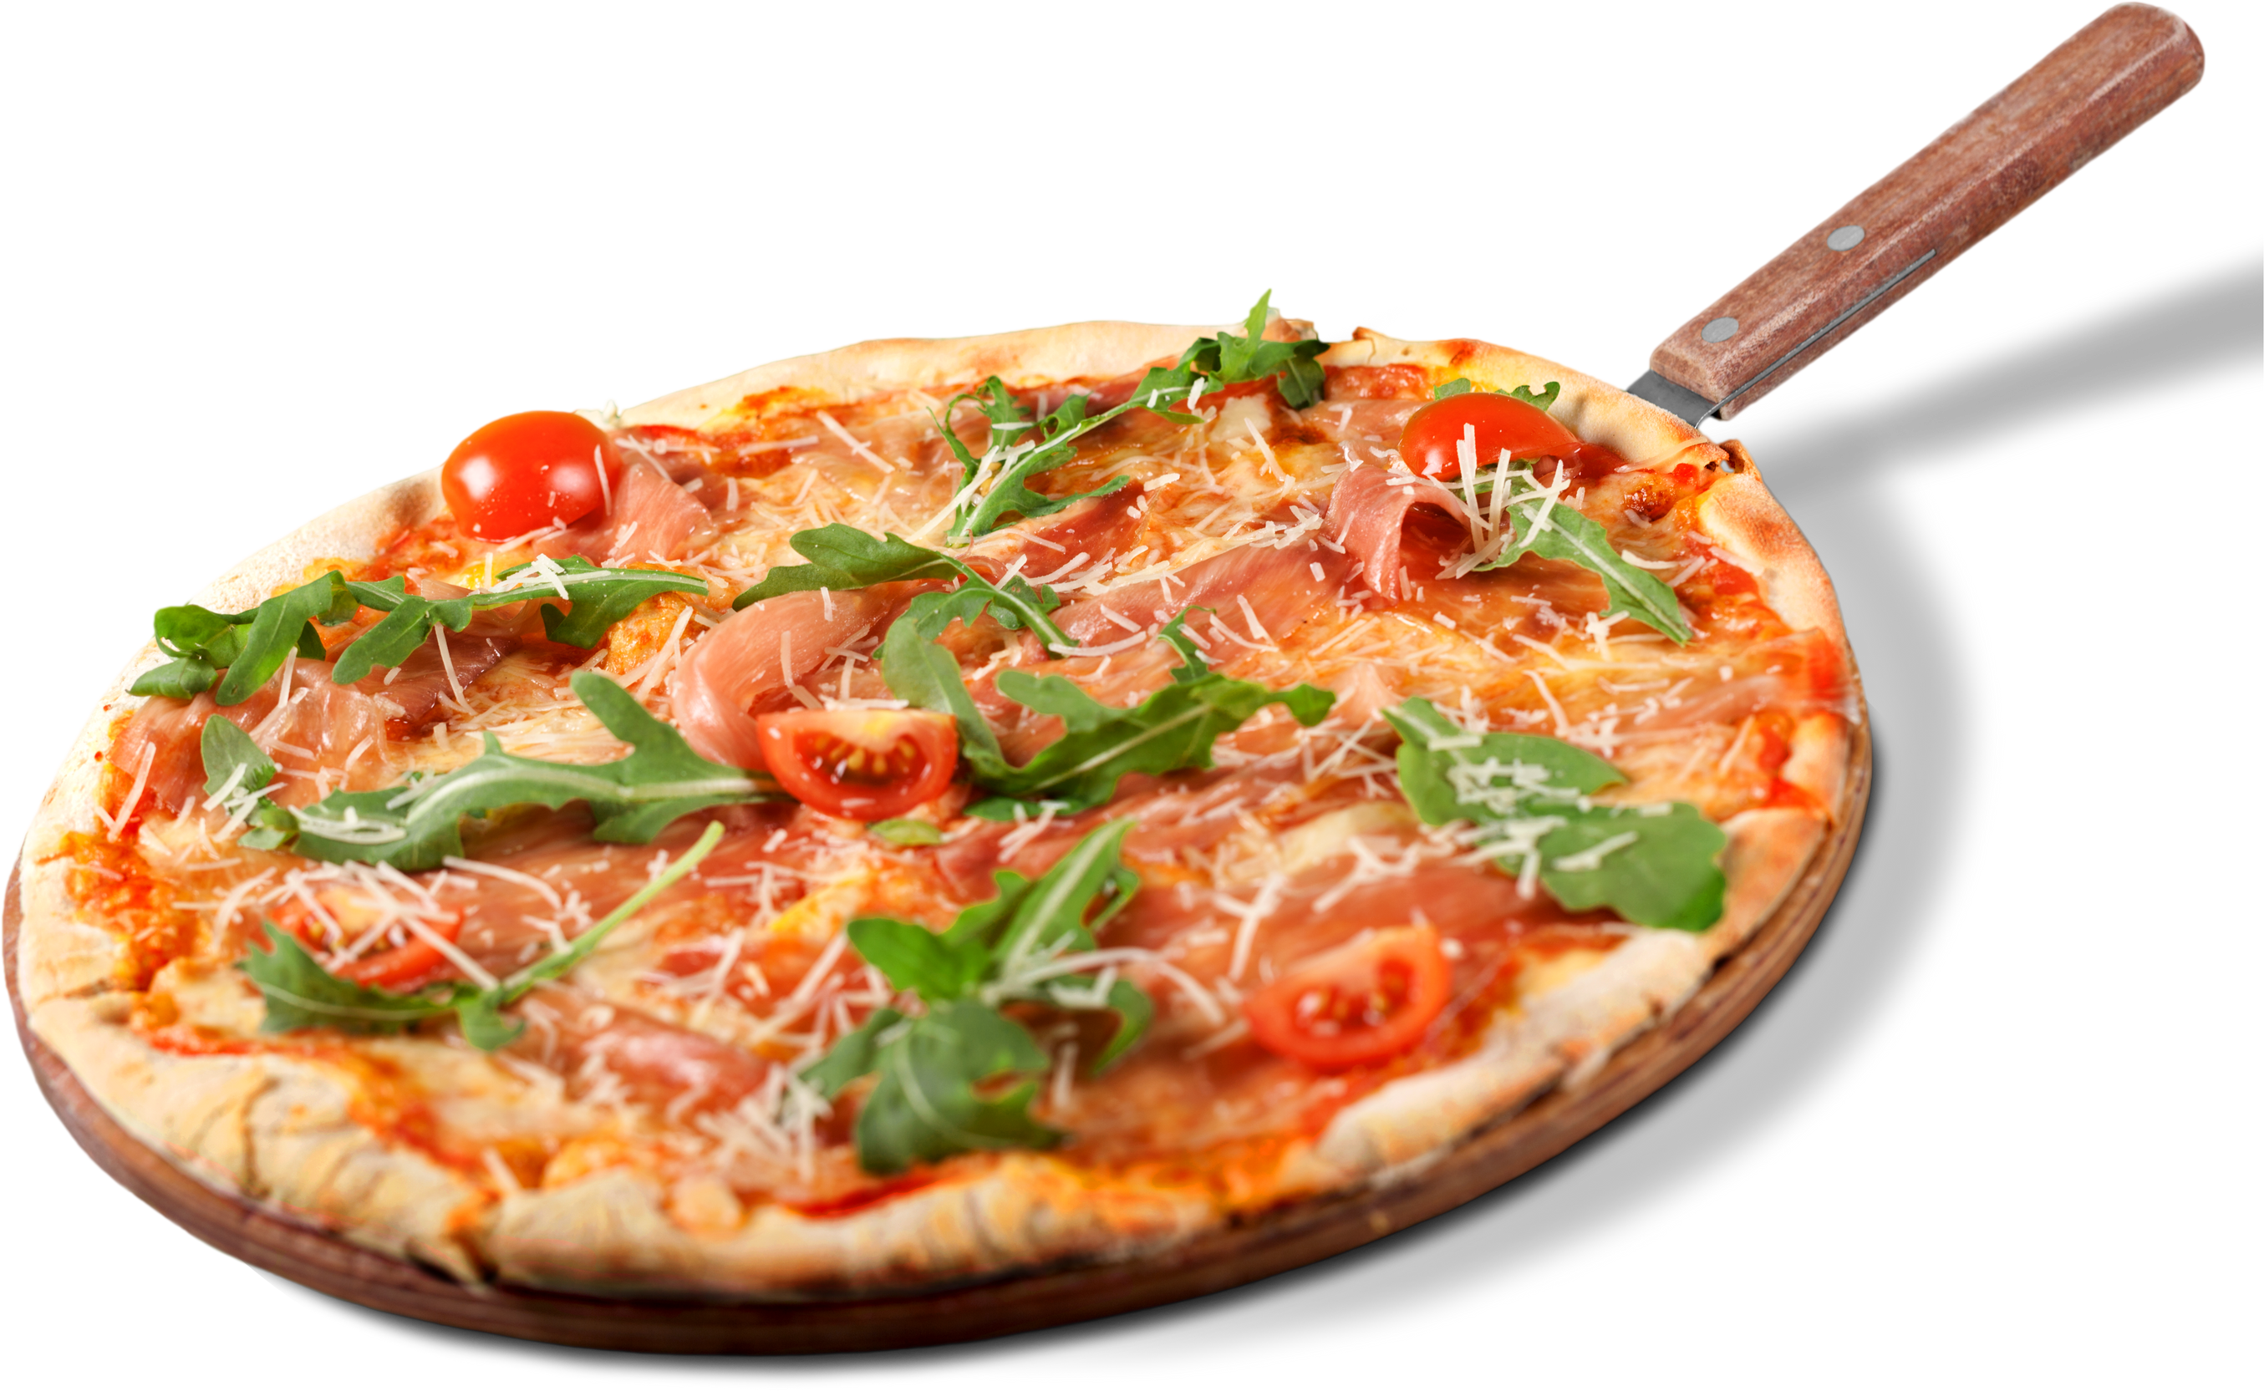
THANKS
FOR YOUR ATTENTION

